Slide 1
Christmas and New Year in GB
Customs and Traditions

Slide 2
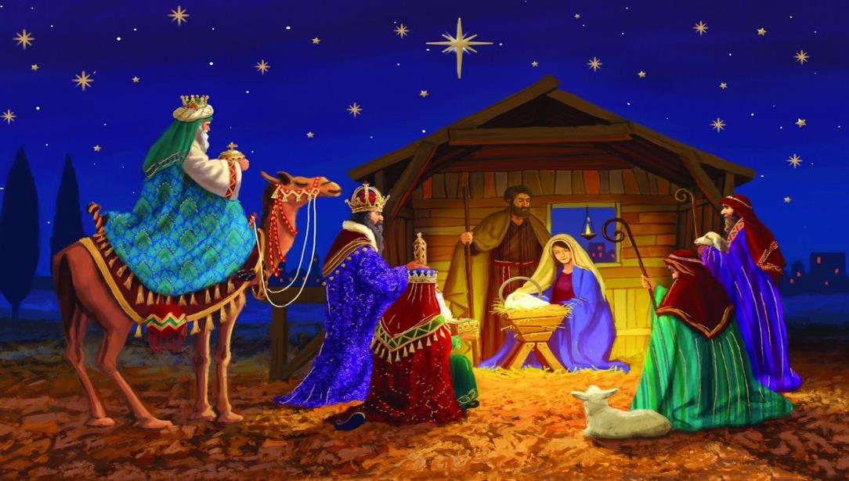
All English people celebrate Christmas on the 25th of December. What kind of holiday is it? It is the yearly celebration of Jesus Christ birth.

Slide 3
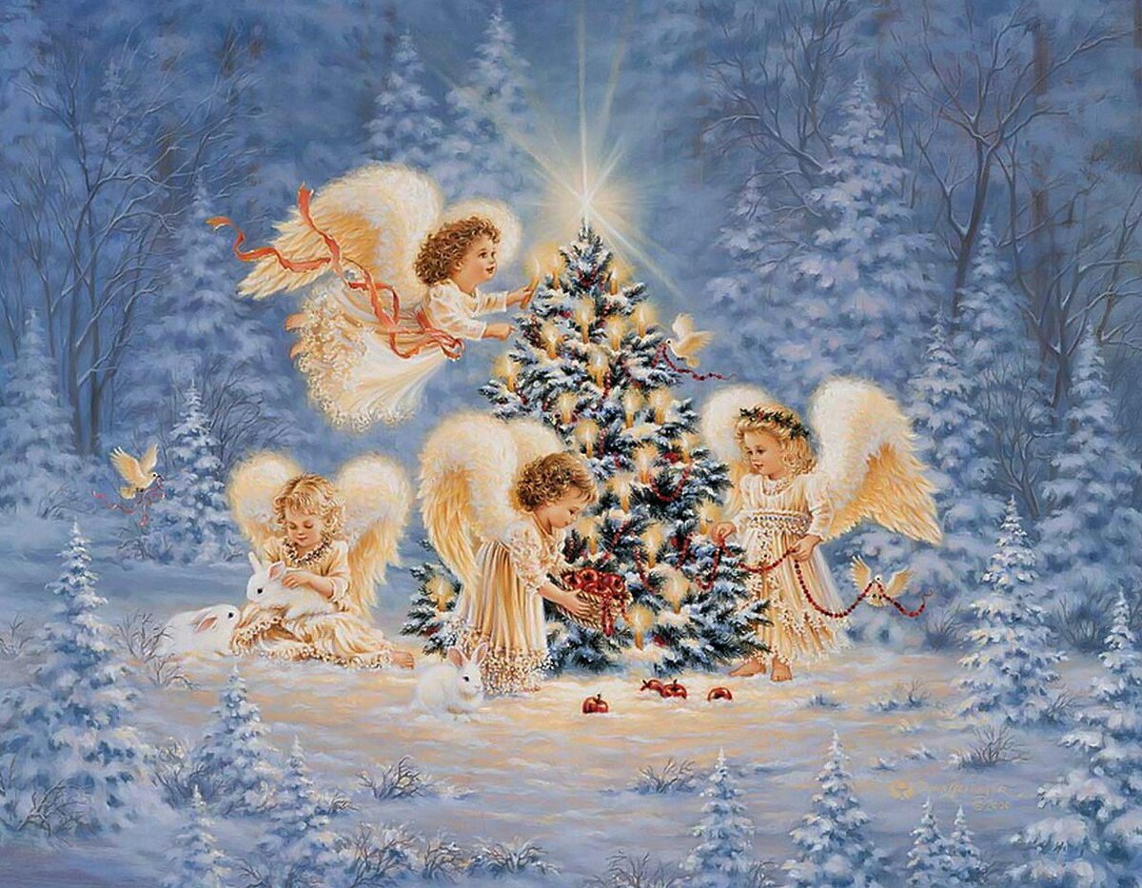
That holiday means the beginning of the new year and life

Slide 4
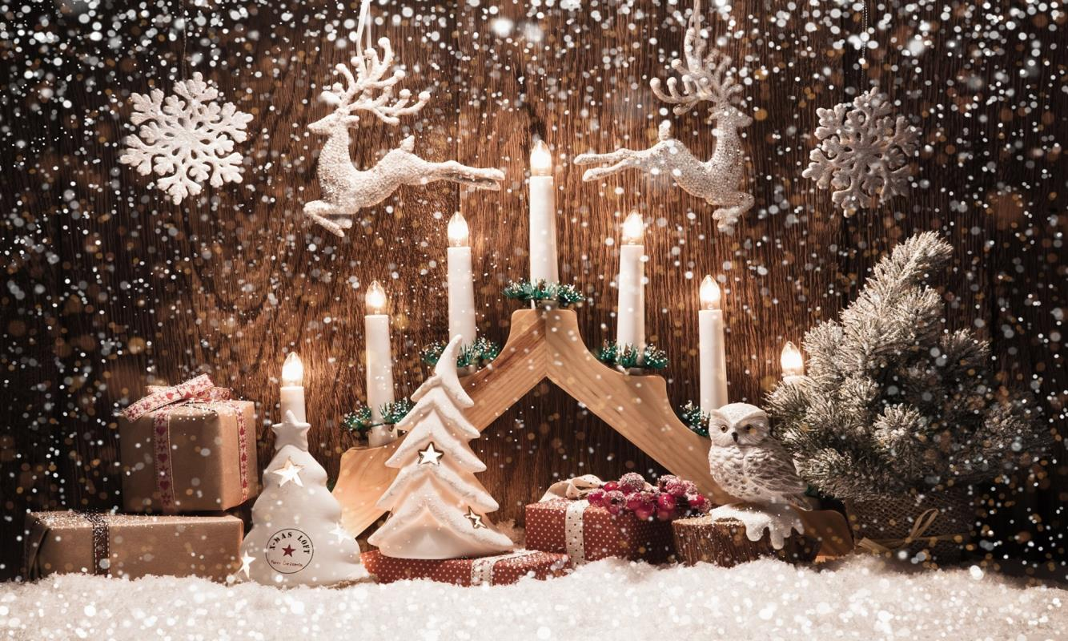
Christmas Day is the greatest holiday in Great Britain. It is interesting visiting the shops for buying our parents, relatives and dear people the presents. There are a lot of nice cards for letters.

Slide 5
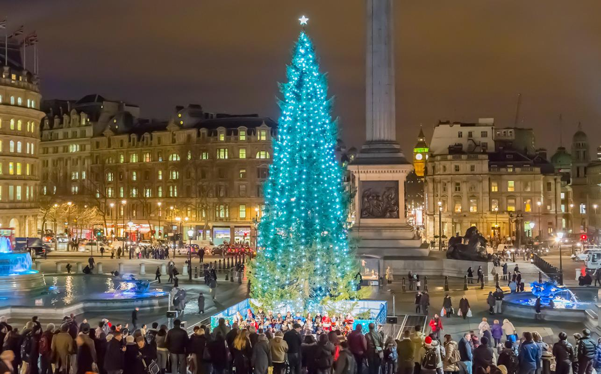
It is interesting to visit London during this holiday. There is a Christmas Tree on Trafalgar Square. One can see many lights, toys, sweets all over the Christmas tree.

Slide 6
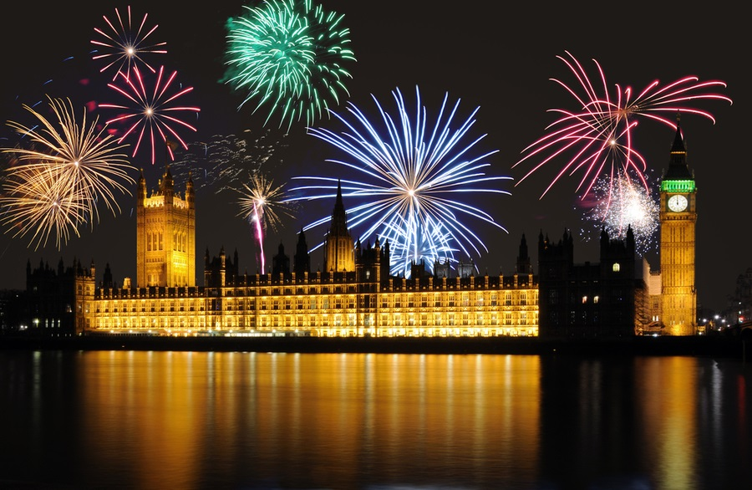
However, even there, the welcoming of the New Year is growing in popularity, particularly among younger people who prefer to spend Christmas with their parents but The New Year with their friends. The New Year’s parties go all night through.

Slide 7
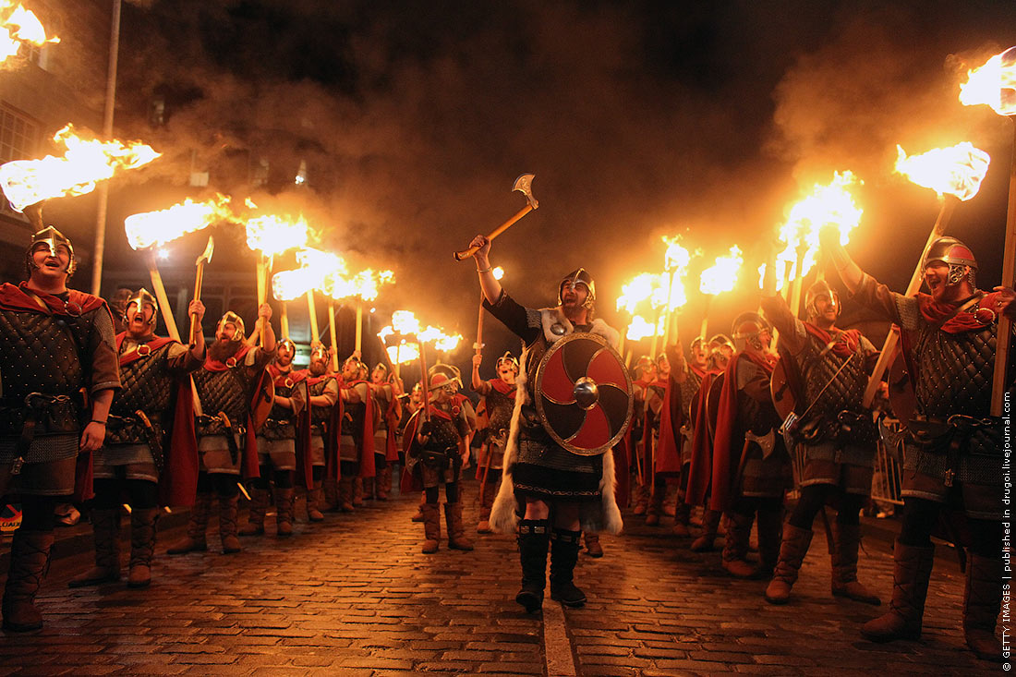
In Scotland, New Year’s celebration is the greatest festival of the year, where it even has a special name Hogmanay. Nobody, however can explain where this word came from.

Slide 8
Презентацию подготовила преподаватель английского языка
Троянова Ксения Сергеевна
Новосибирский медицинский колледж.
2020г.

